Slide 1
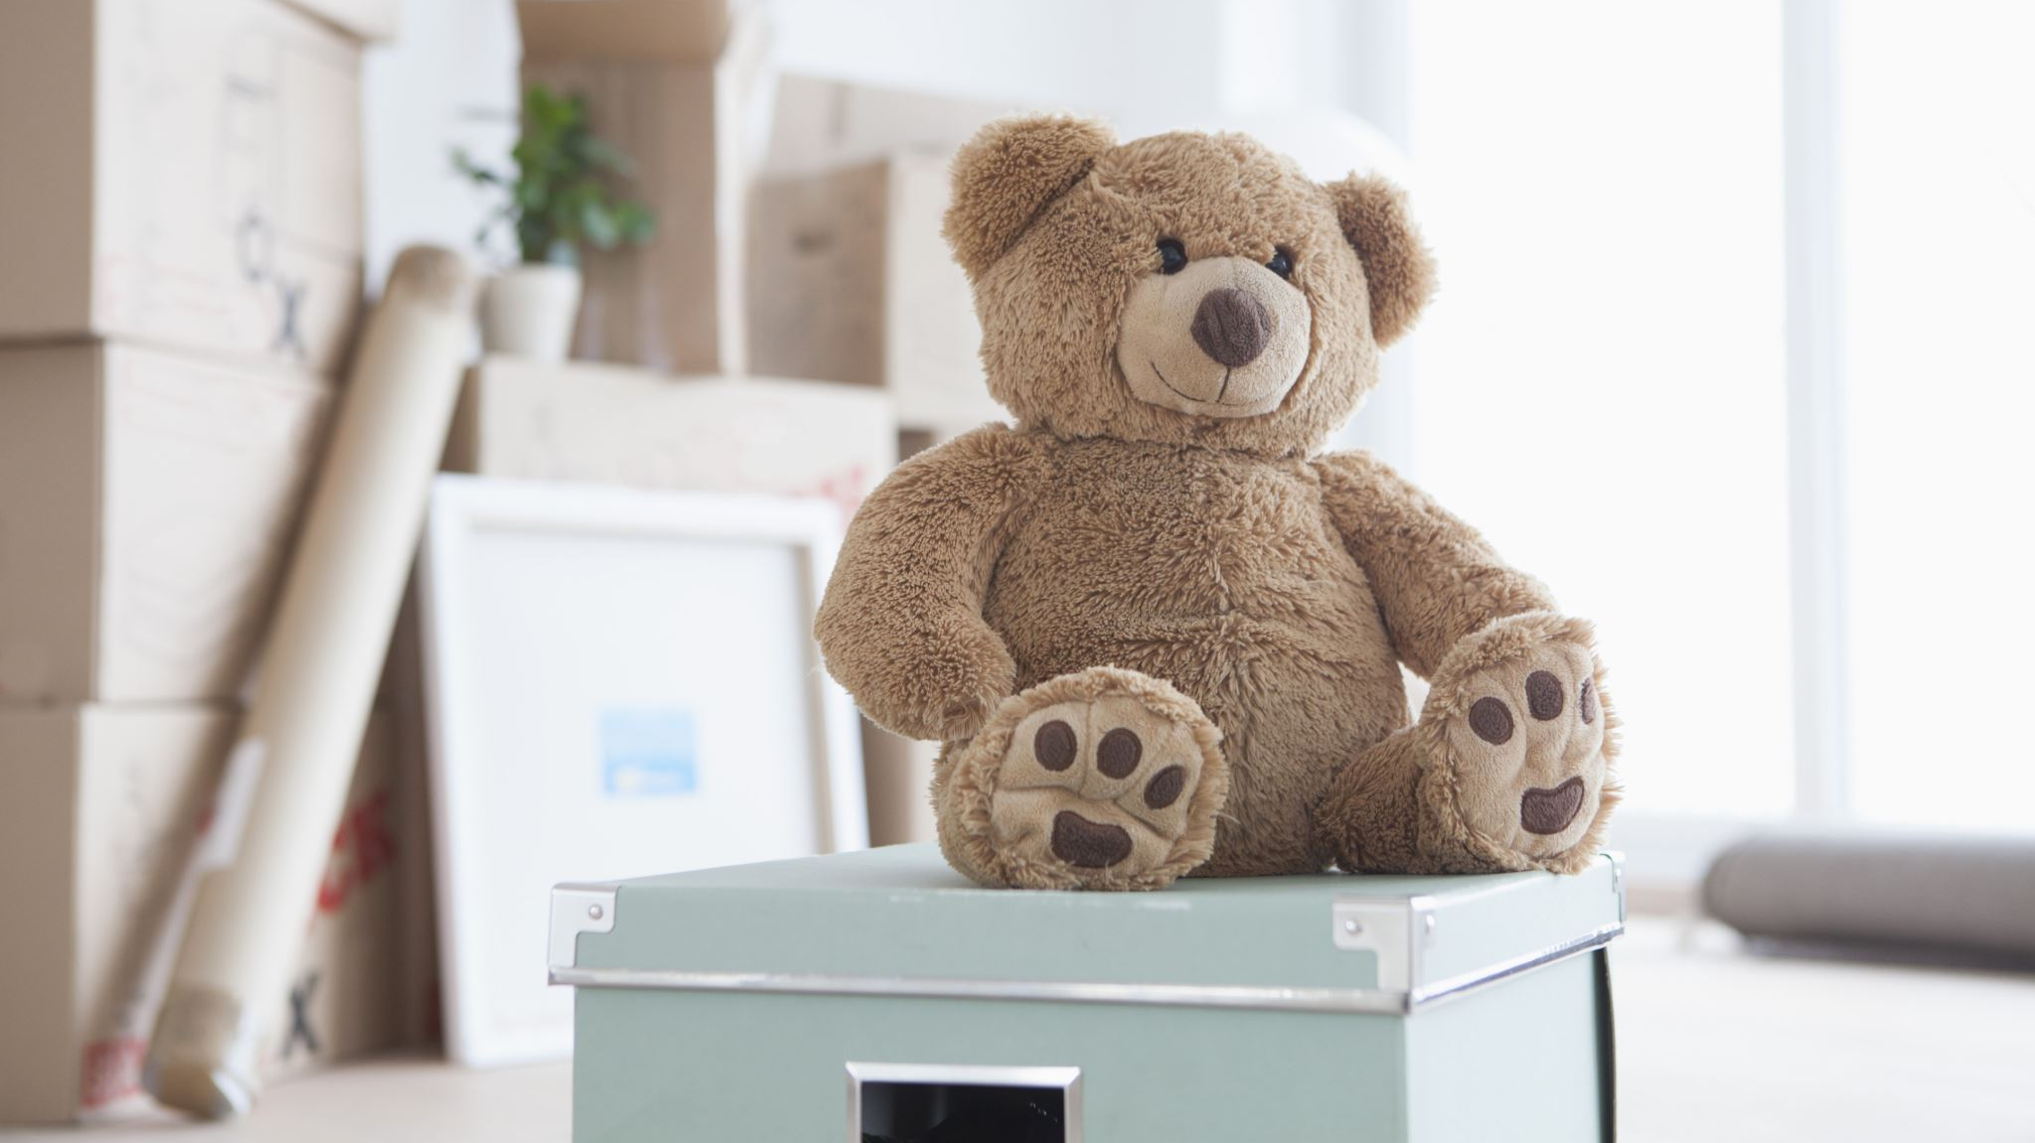
Unit 9:
What ? are you wearing?
Lesson one: Vocabulary

Slide 2
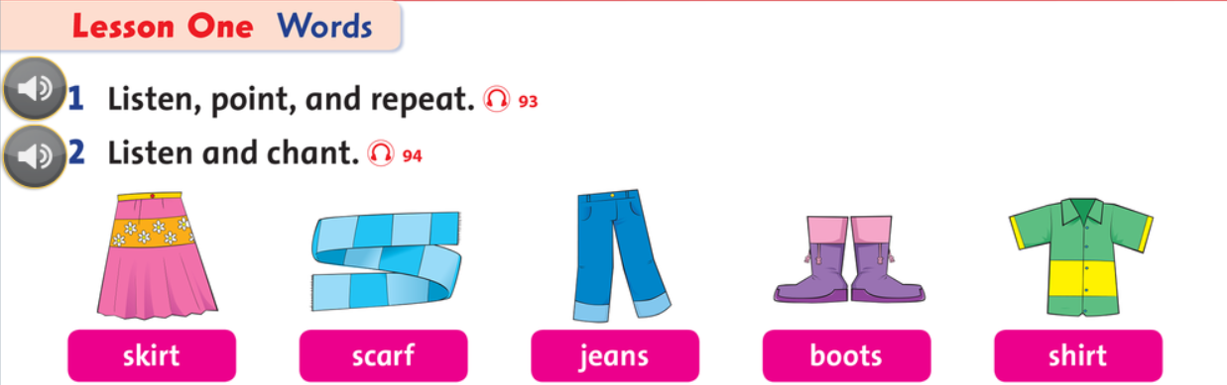

Slide 3
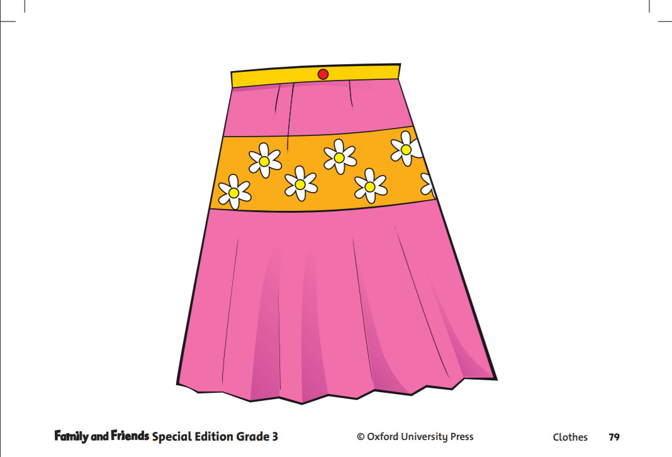
Skirt /skɜːt/
noun
Definition:
A piece of clothing, usually wear by girls, and does not have legs.
Example:
My friend, Linh, has a pink and yellow skirt.

Slide 4
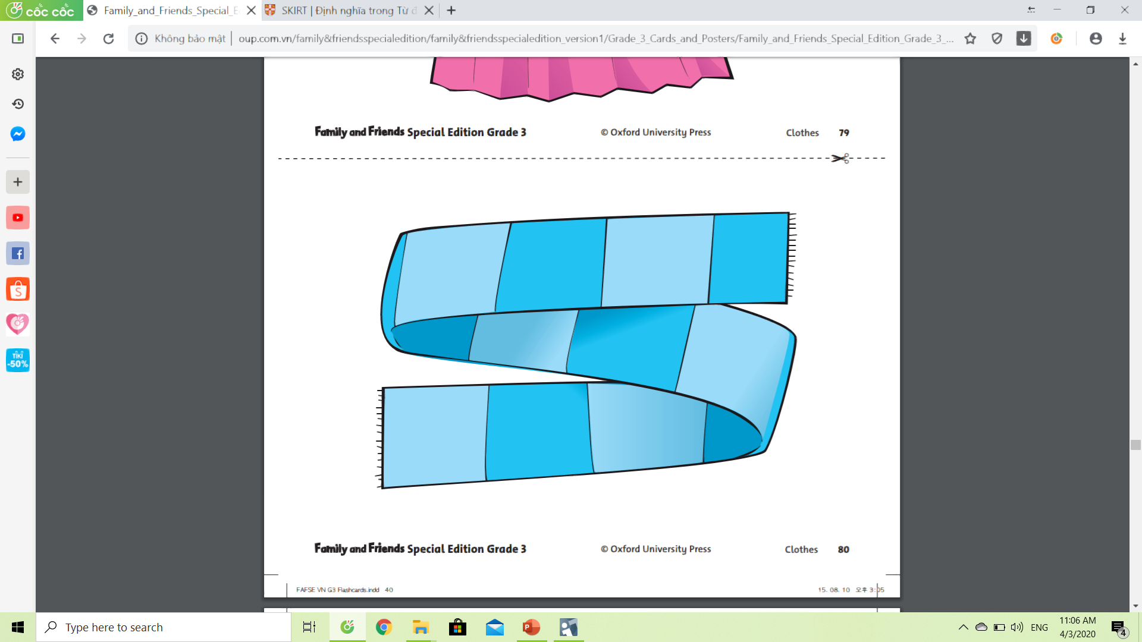
Scarf
noun
/skɑːrf/
Definition:
A piece of clothing, usually wear when it’s cold to keep your neck warm.
Example:
It’s snowy, so, my mom tell me to put on a scarf.

Slide 5

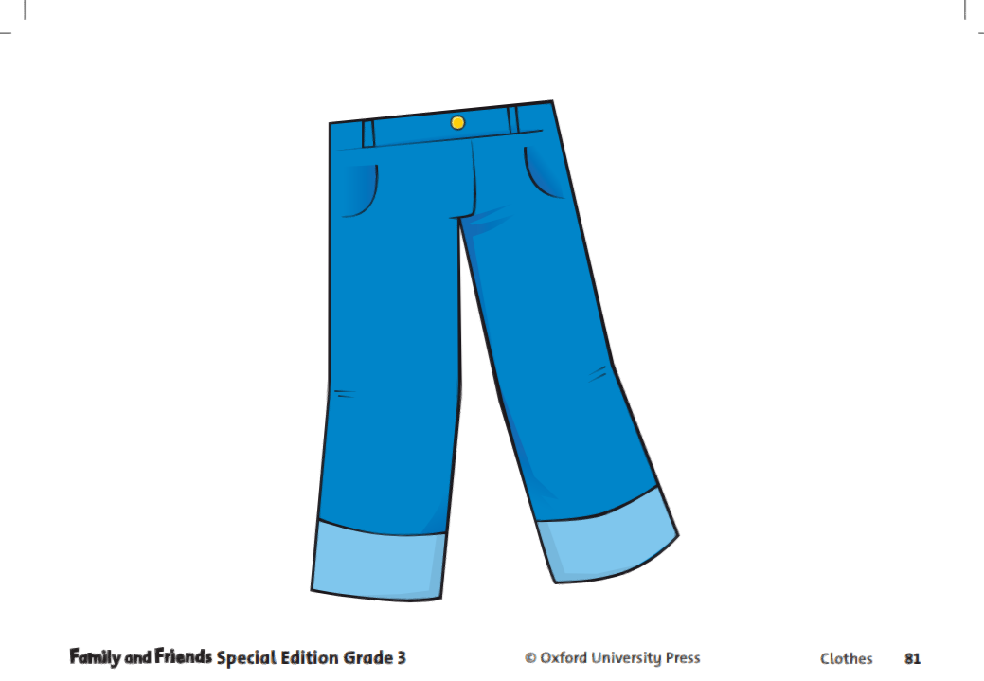
Jeans
noun [ plural ]
/dʒiːnz/
Definition:
A thicker, stronger pants. Usually made of cotton. You, sometimes, wear jeans to school on party days.
Example:
My father has a blue jeans in his cabinet.

Slide 6
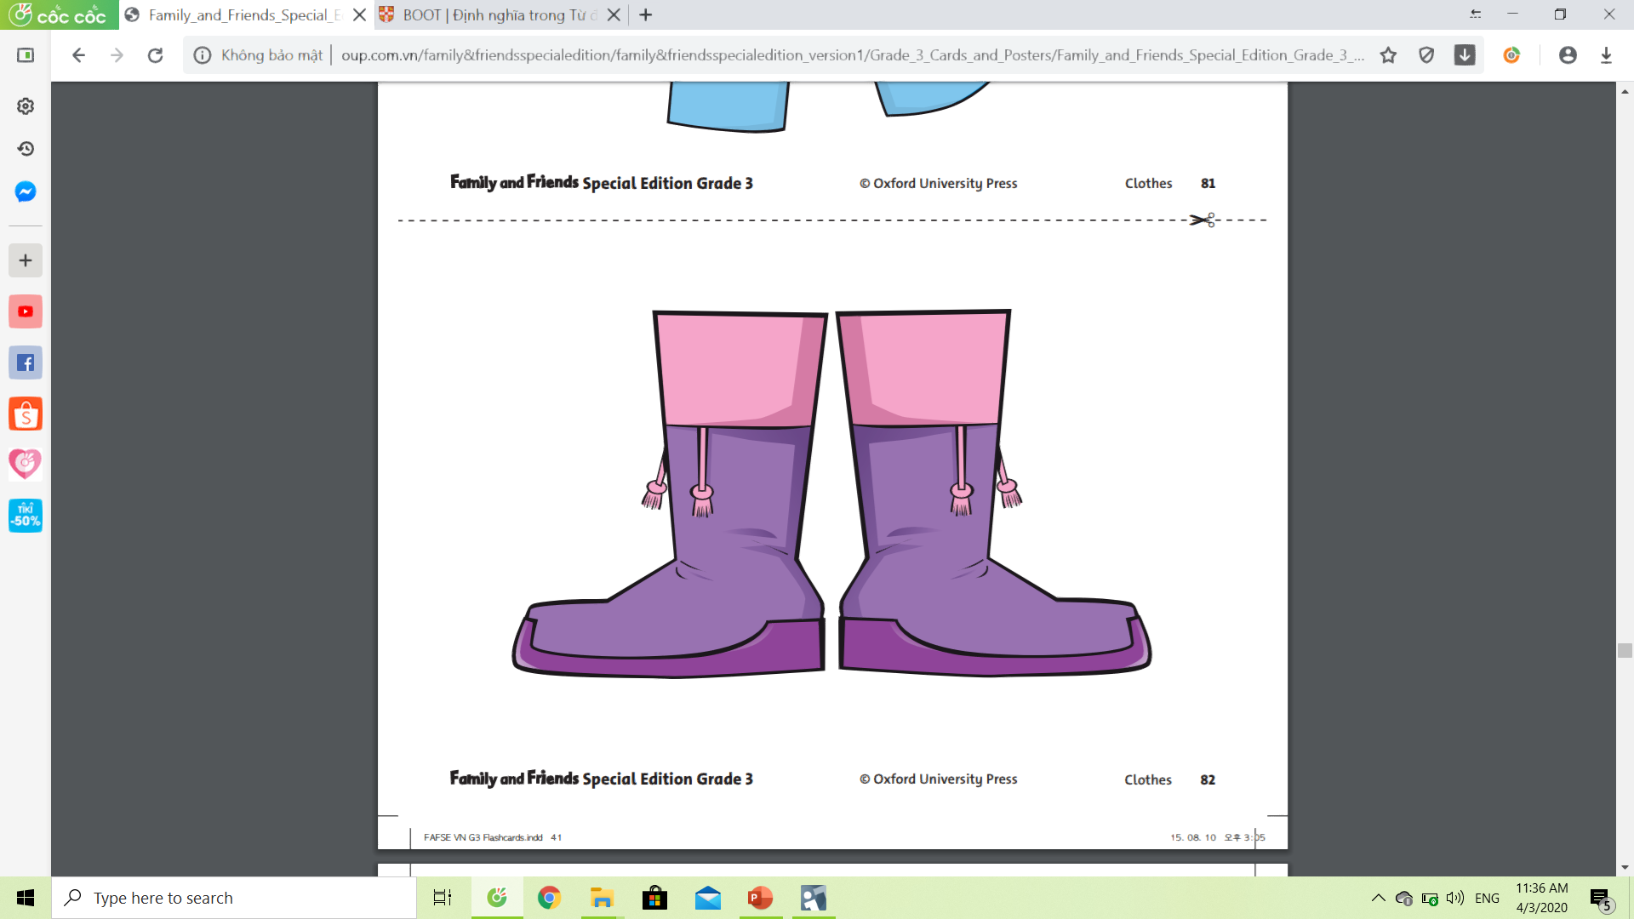
Boot
noun
/buːt/
Definition:
A shoe that has high ankle covering for the foot and some of the leg. It’s usually made of leather or rubber.
Example:
It’s raining. Put on your boot to keep your foot dry.

Slide 7
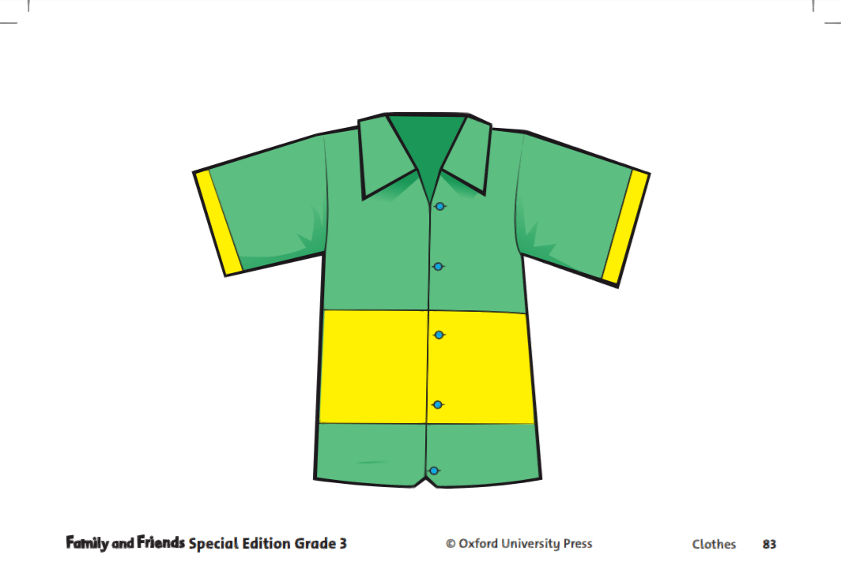
Shirt
noun
/ʃɝːt/
Definition:
A piece of clothing worn on the body, usually has button and collar.
Example:
Everyday, I wear my white shirt to school.

Slide 8

Guess

Slide 9
Boots

Slide 10
Shirt

Slide 11
Skirt

Slide 12
Scarf

Slide 13
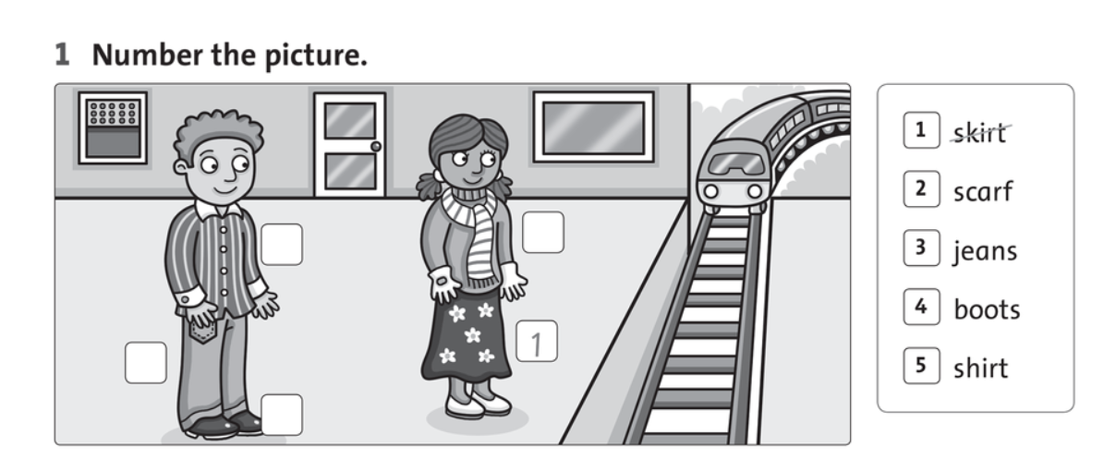
Part 3: Exercises (Wordbook page 60)
5
2
3
4

Slide 14
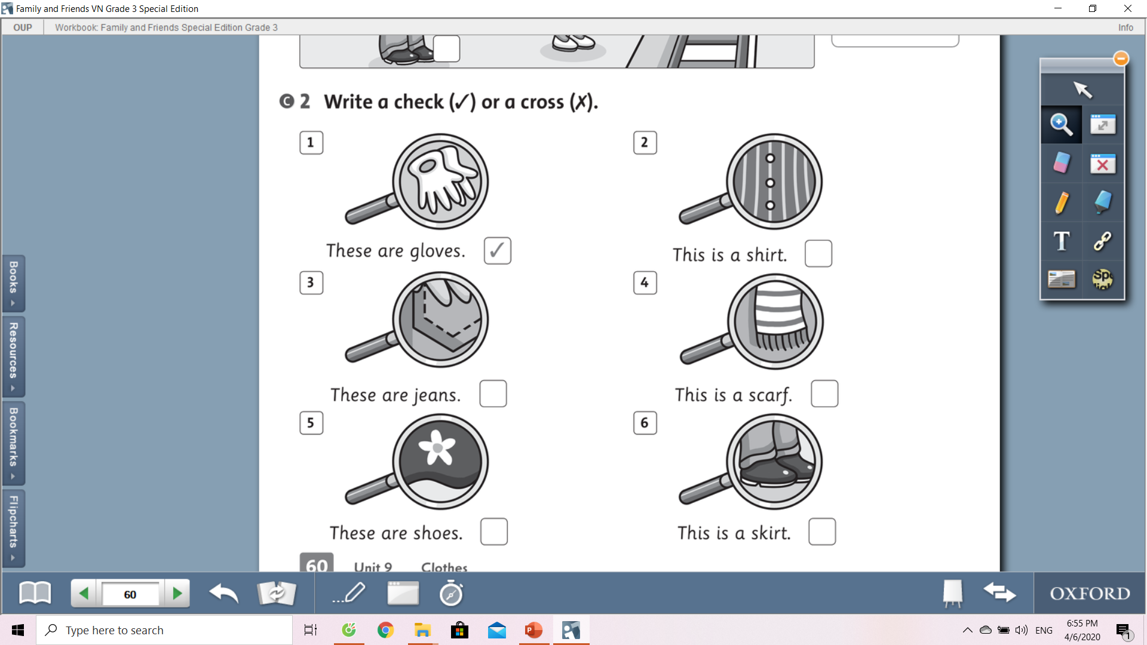
Part 3: Exercises (Wordbook page 60)
a
a
a
r
r

Slide 15


Good bye everyone!
Don’t forget to do your exercises.
Stay at home and be safe!

